Slide 1
Online beauty parlour management system

Slide 2
introduction
Web-based salon management application with appointment scheduling functionality.
Developed to automate all the salon activity.
In this system beauty parlor owner can make their account online and give details of the services they offer and also describe the stylist information.

Slide 3
introduction
The users of the system include the customers where they can register initially with the minimum details and will be allowed to make an appointment.
All these activities of making appointments such as choosing service as well as date and time will be recorded in the database for all the events.

Slide 4
OBJECTIVE OF PROJECT
To evaluate best solution for booking online appointments and manage the same.
To develop the outlook type schedule with different views to display the appointments and perform various actions on that.
To develop secure web-based access to the Users, Powerful search capability of appointments.

Slide 5
OBJECTIVE OF PROJECT
Development of web applications for salons to manage their daily schedules.
To manage the accounts of customers, salon owners.
To implement web-based Payments and confirmation email.

Slide 6
Features of OBPMS
Appointment Scheduling
Online Booking Mechanism
Increase Client Retention with Feedback Management
Customer Advance & Package Management
Performance Analyzer

Slide 7
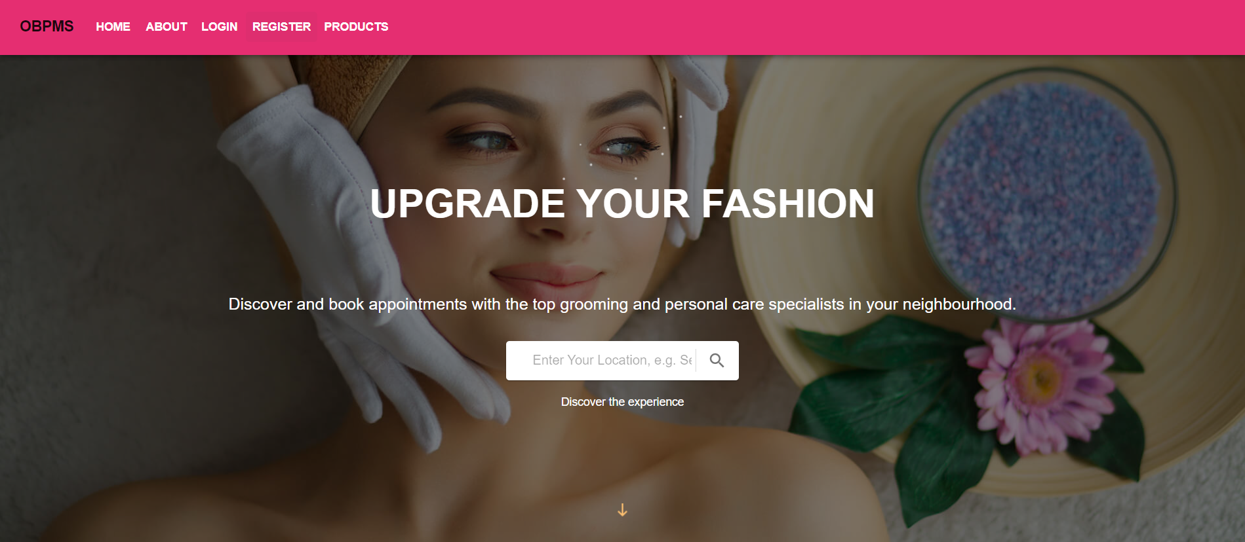
Modules of OBPMS(USER OR CLIENT MODULE)
Homepage: This page consists of overview of Online Beauty Parlour Management system, how it works, what are the features of it and what type of service provided by it.

Slide 8
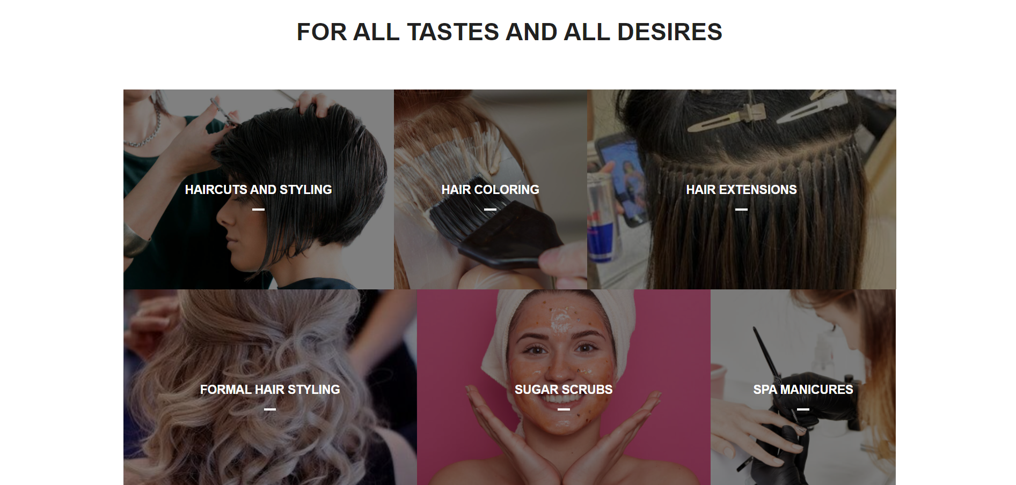
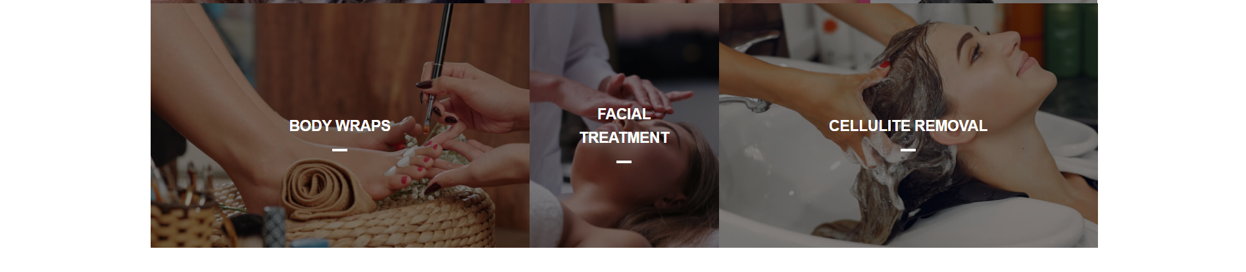
Modules of OBPMS(USER OR CLIENT MODULE)

Slide 9
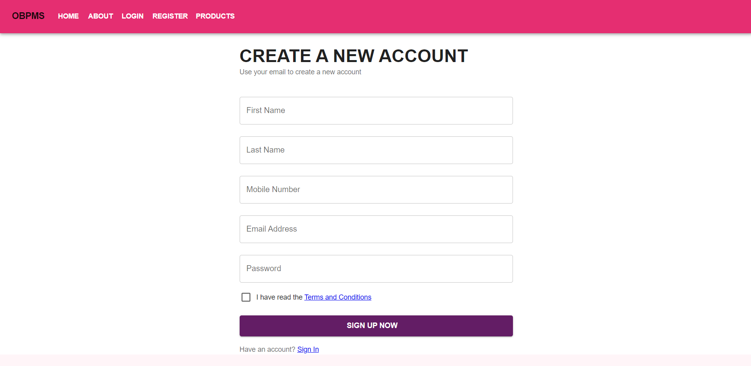
Modules of OBPMS(USER OR CLIENT MODULE)
Signup: Using this page, user can register yourself using First Name, Last Name, Mobile Number, Email id and password. Each field is protected with some validation method using regular expressions.

Slide 10
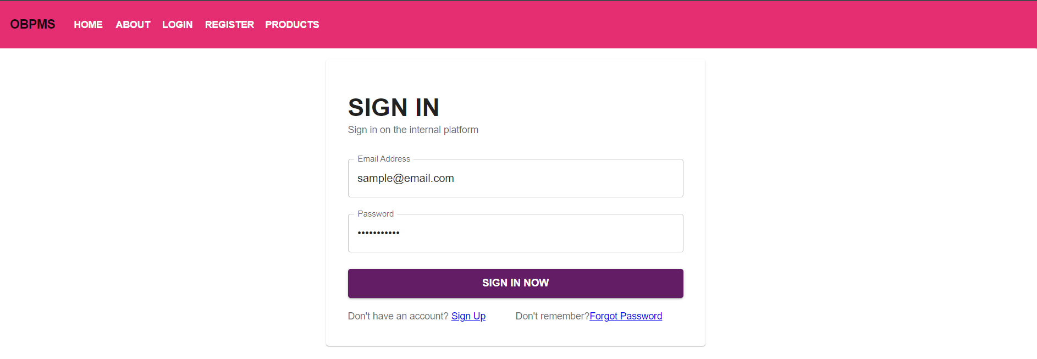
Modules of OBPMS(USER OR CLIENT MODULE)
Login Page: User can login using email id and password to book appointment.

Slide 11
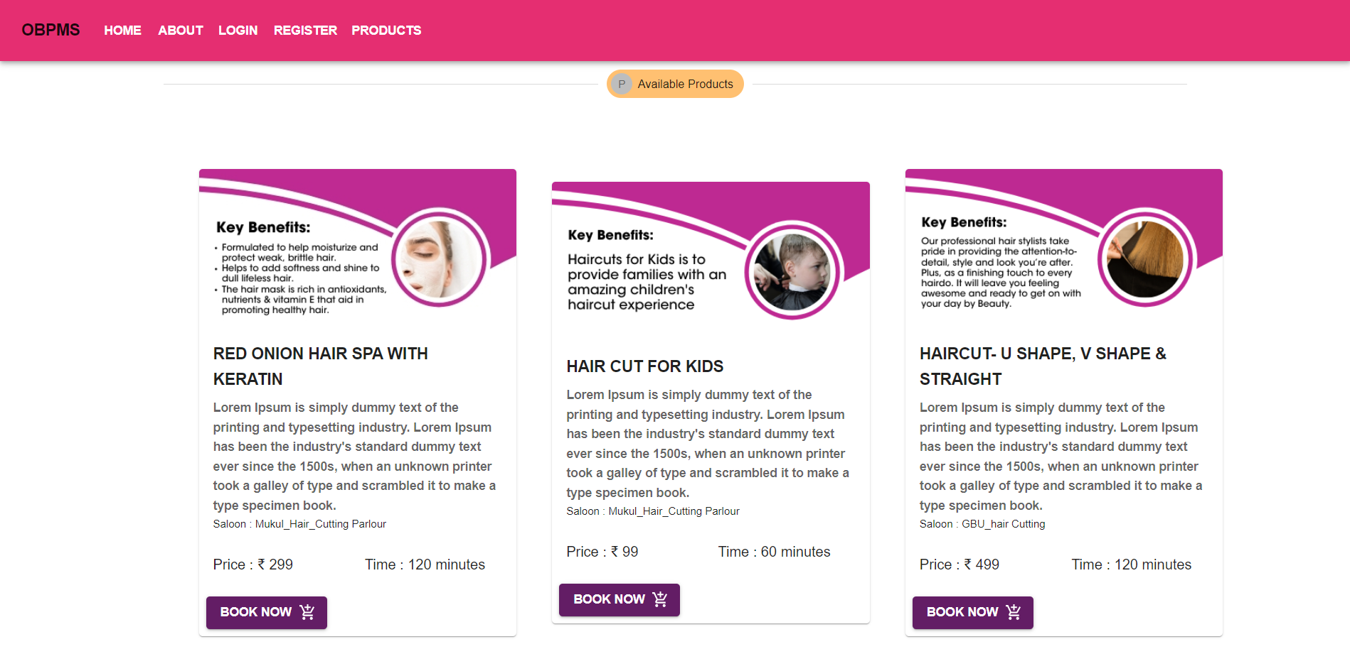
Modules of OBPMS(USER OR CLIENT MODULE)
Product Page: This page will display all products added by different parlours having information such as product name, description, parlour name, price and time required to complete that task by parlours.

Slide 12
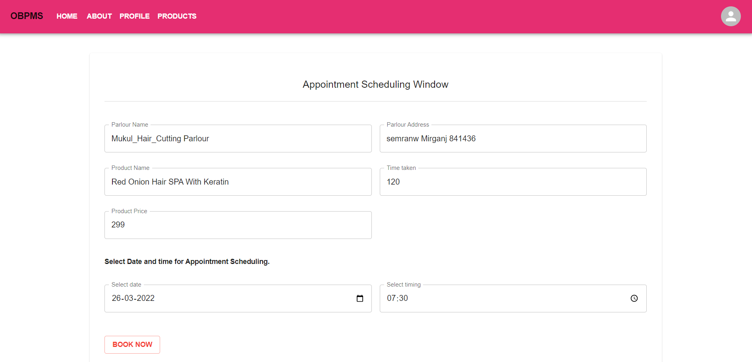
Modules of OBPMS(USER OR CLIENT MODULE)
Appointment window: This window will open after selecting to book appointment for particular appointment by filling their choice of time.

Slide 13
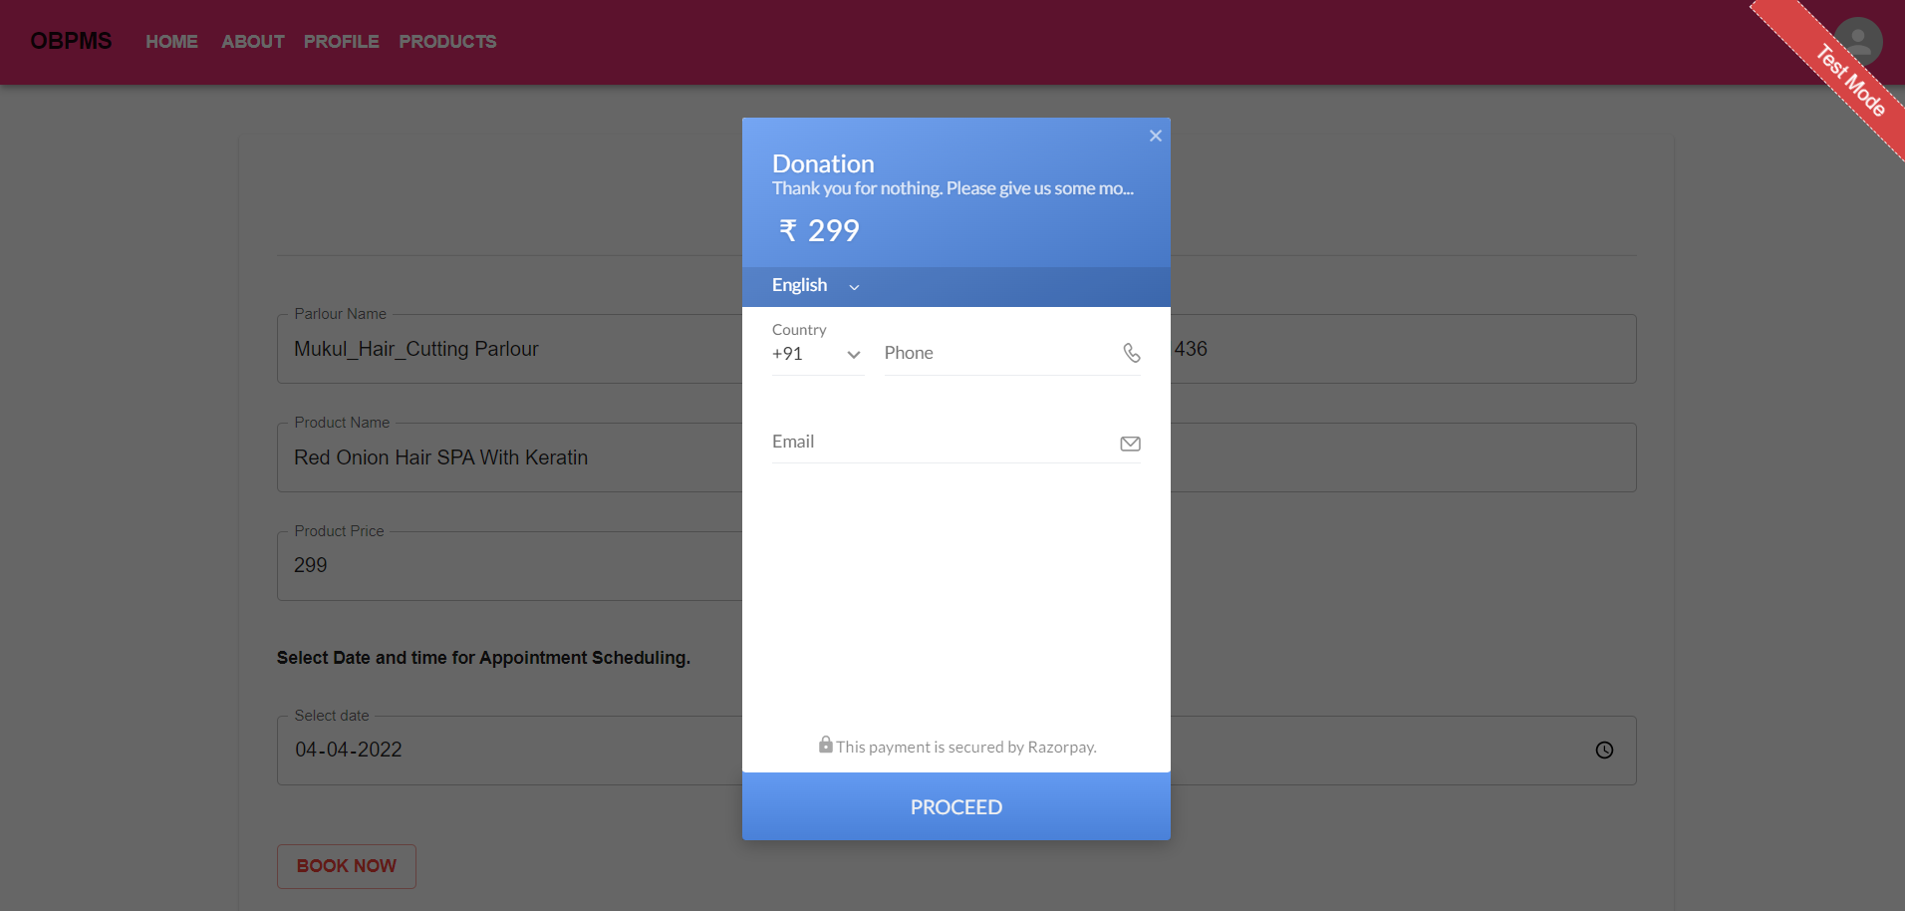
Modules of OBPMS(USER OR CLIENT MODULE)
Payment window: This window will open after appointment scheduling window. After entering all payment information like credit card, debit card, upi or any wallets for payment.

Slide 14
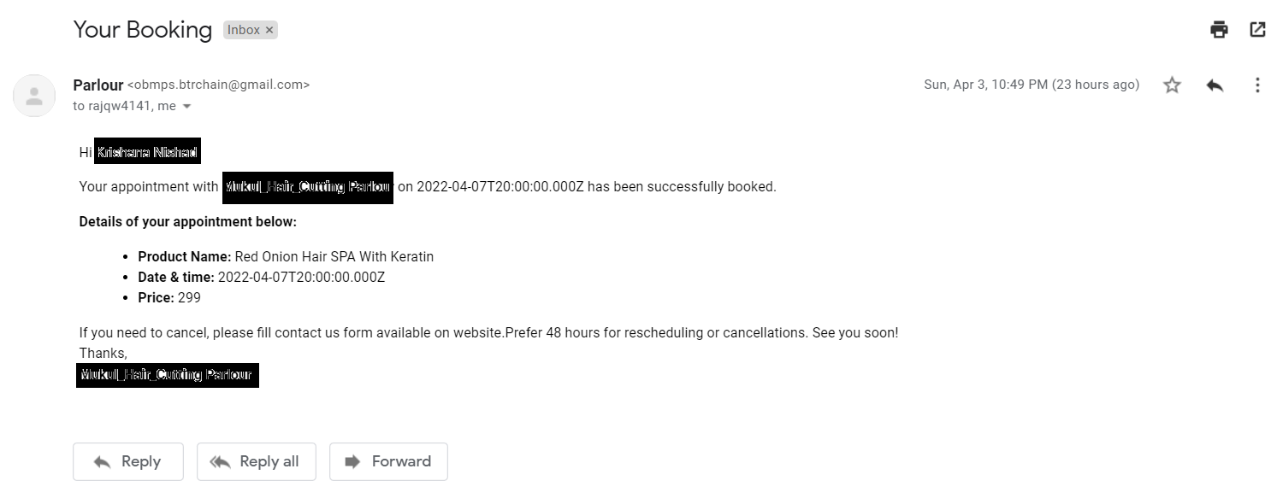
Modules of OBPMS(USER OR CLIENT MODULE)
Confirmation mail: This will be the confirmation mail will send to registered email id.

Slide 15
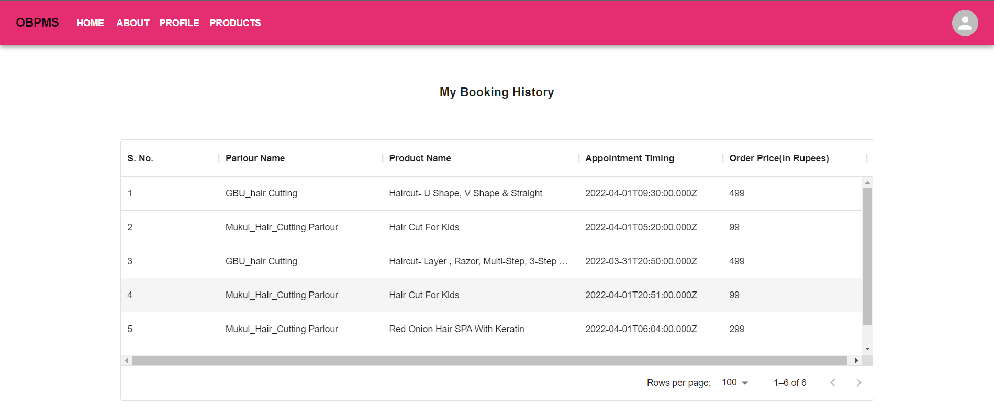
Modules of OBPMS(USER OR CLIENT MODULE)
Booking History: This section shows all appointments booked by the user logged in.

Slide 16
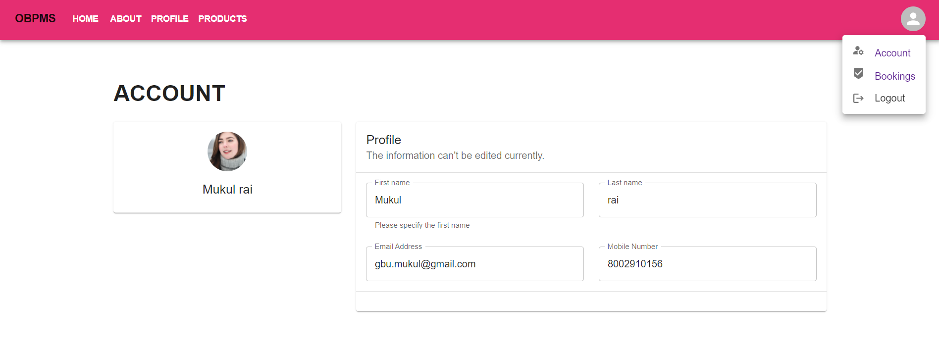
Modules of OBPMS(USER OR CLIENT MODULE)
User profile: This section consists of all information about users filled during signup process.

Slide 17
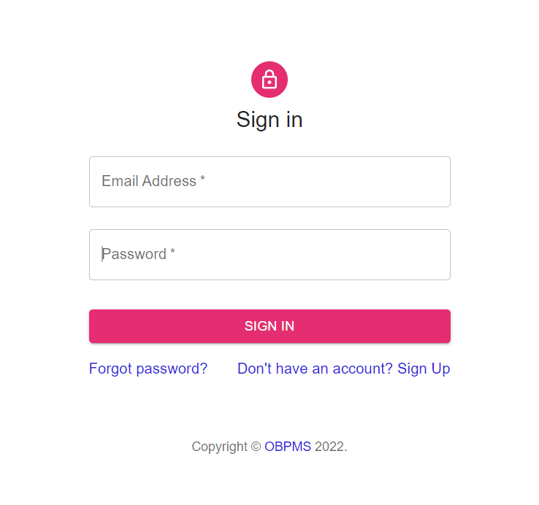
Modules of OBPMS(PARLOUR OR SALOON MODULE)
Login Page for parlour: User can login using email id and password to book appointment.

Slide 18
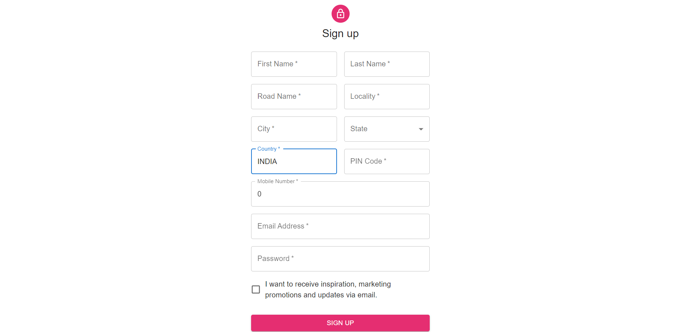
Modules of OBPMS(PARLOUR OR SALOON MODULE)
Signup: Using this page, parlour can register yourself using First Name and Last Name of saloon, Mobile Number, address, Email id and password. Each field is protected with some validation method using regular expressions.

Slide 19
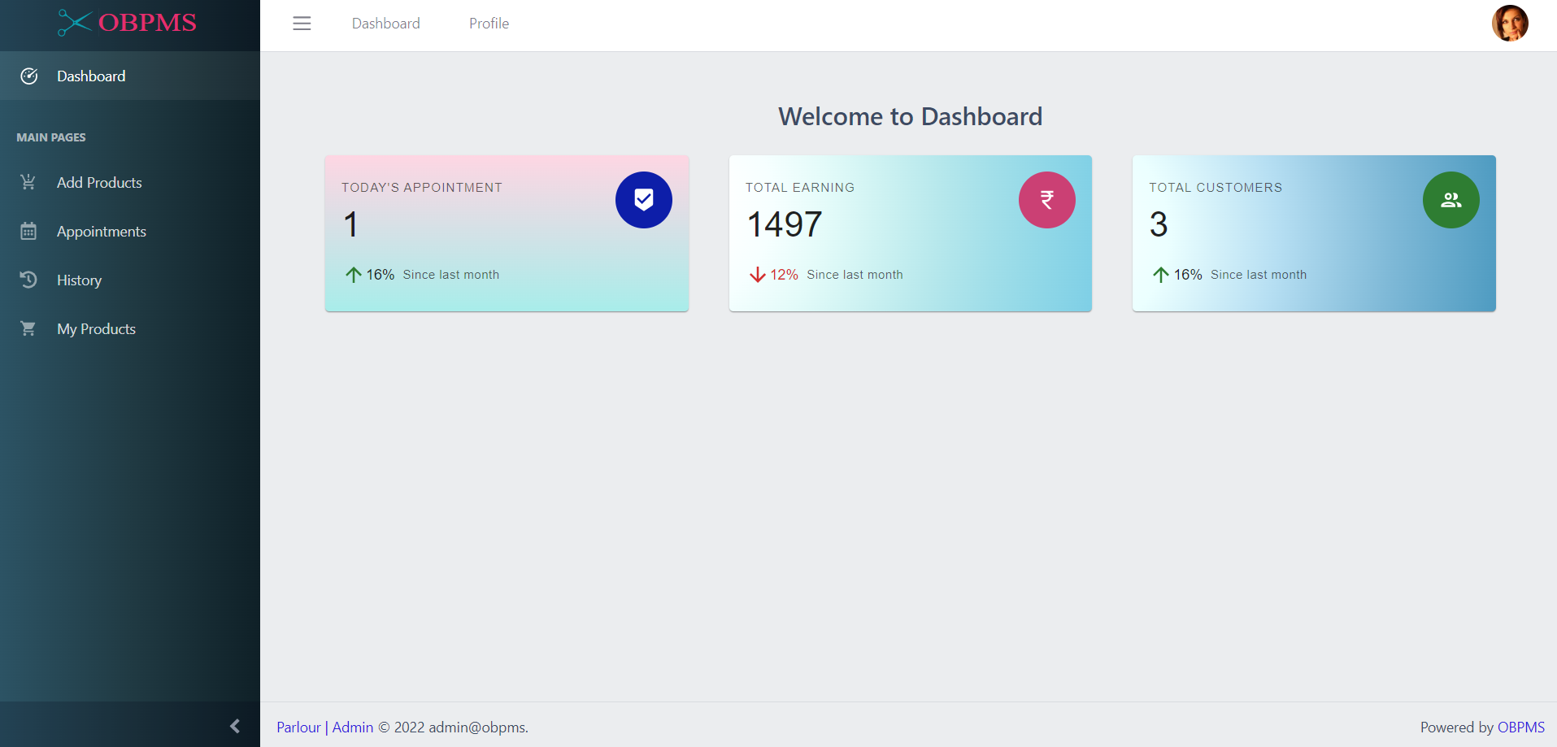
Modules of OBPMS(PARLOUR OR SALOON MODULE)
Parlour Dashboard: This window shows all details such as todays appointments, total earnings and total customer served today.

Slide 20
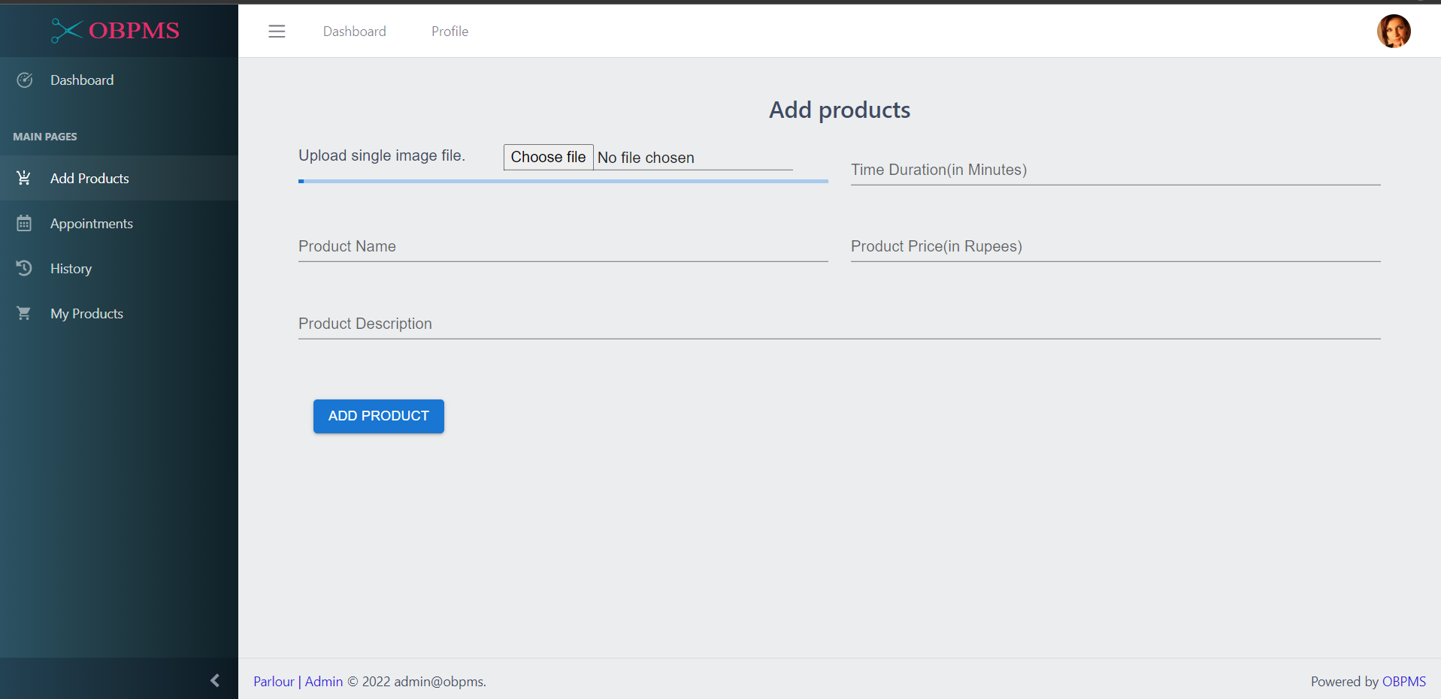
Modules of OBPMS(PARLOUR OR SALOON MODULE)
Add product: Using this window parlour can add their variety of products and services by filling name, duration, description and image of product and services .

Slide 21
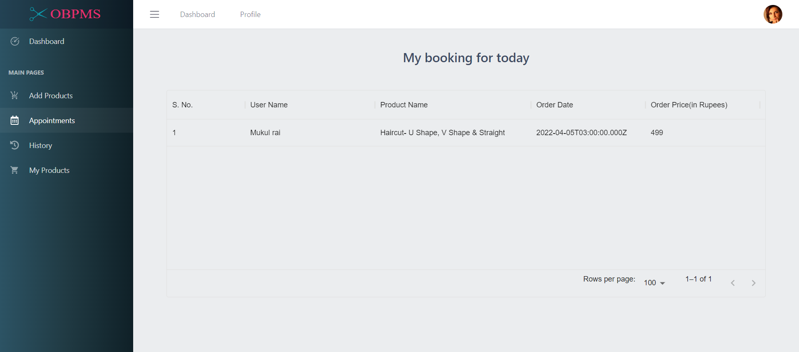
Modules of OBPMS(PARLOUR OR SALOON MODULE)
Today’s booking history: This window shows today’s bookings and also it can be filtered in alphabetical order of product, pricing order and username.

Slide 22
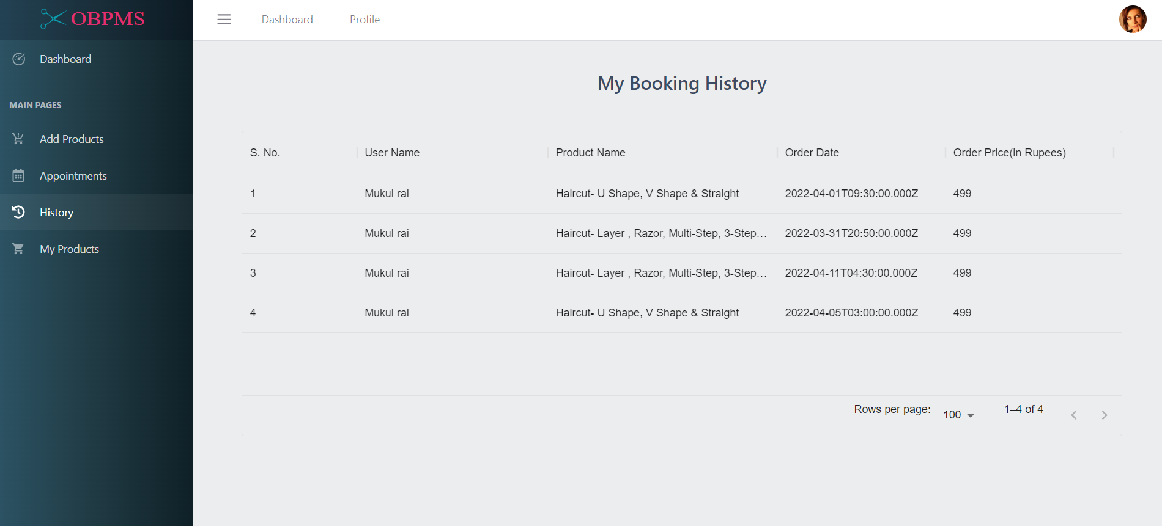
Modules of OBPMS(PARLOUR OR SALOON MODULE)
All booking history: This window shows all booking history and also it can be filtered in alphabetical order of product, pricing order and username.

Slide 23
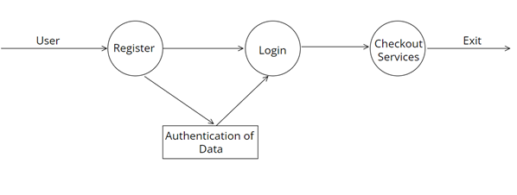
Data flow diagram
Data flow diagram is a graphical representation of flow of data in an information system. It is capable of depicting incoming data flow, outgoing data flow and stored data. The DFD does not mention anything about how data flows through the system.

Slide 24
REQUIREMRNTS
HARDWARE REQUIREMENT
This web app is required following hardware for smooth working.
SOFTWARE REQUIREMENT
NodeJS
Visual Studio
Windows 10/11 or Any Linux distribution
MongoDB
Component | Minimum requirement
Processor | 32-bit, 2-cores, 2.5 GHz minimum per core
RAM | 4 GB
Hard disk | 10 GB

Slide 25

TECHNOLOGIES USED
Reactjs: ReactJS is a declarative, efficient, and flexible JavaScript library for building reusable UI components.

Slide 26

TECHNOLOGIES USED
NodeJS: Node.js is an open-source and cross-platform JavaScript runtime environment. It is a popular tool for almost any kind of project!

Slide 27

TECHNOLOGIES USED
MongoDB: MongoDB is an open-source document database that provides high performance, high availability, and automatic scaling.

Slide 28


